Slide 1
End User Cartridge Management Foglight
James Wang
Team Lead, Software Development
Email : james.wang@quest.com
Nov 22nd 2012, @Foglight & vFoglight Dev Camp, China

Slide 2
What we’re going to cover
End User Monitoring Architecture
Key Improvements
How Analysis Works
Search & Session Explorer
End User Monitoring & APM in the future

Slide 3
End User Monitoring Architecture

Slide 4
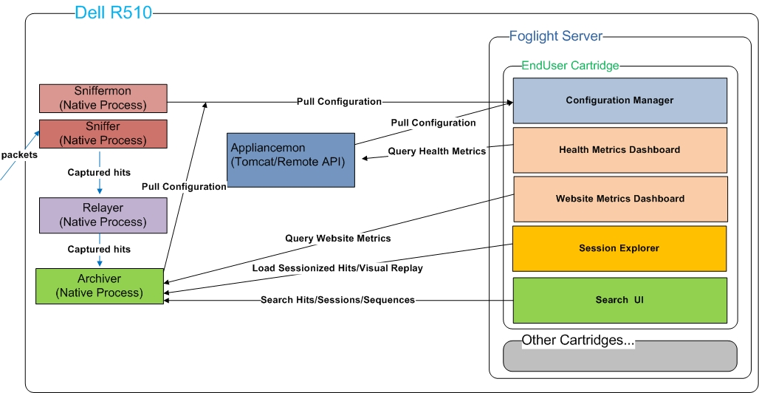
End User Monitoring Architecture
Logic Components

Slide 5
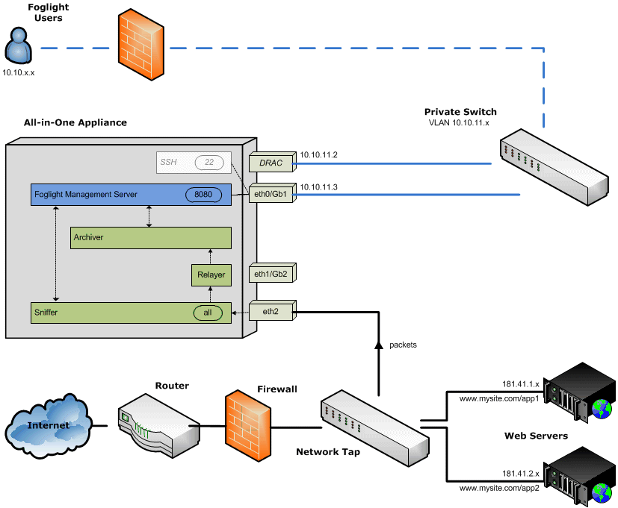
End User Monitoring Architecture
Deployment Architecture

Slide 6
Key Improvements

Slide 7
Key Improvements
Appliances
One hardware model (Dell R510)
Instead of two today (R310/R710)
For sales, easier sizing & capacity planning
For R&D, much less effort towards hardware
Appliance Maintenance Lifecycle
Single ISO image
Unified upgrades based on unified RPM packing
Fewer appliance components at runtime
Virtual Appliances for customer-supplied hardware

Slide 8
Key Improvements
Config / Reporting
90% configuration in Foglight Server
Instead of today’s separately configured components (FxM & FxV)
One Foglight based UI for configuration
Appliance setup menus for remaining 10% of configuration
All Reporting via Foglight Server
One datasource that provides all eu data
Simplified topology model unifies all eu data (even APM data in spiderman)

Slide 9
How Analysis Works

Slide 10
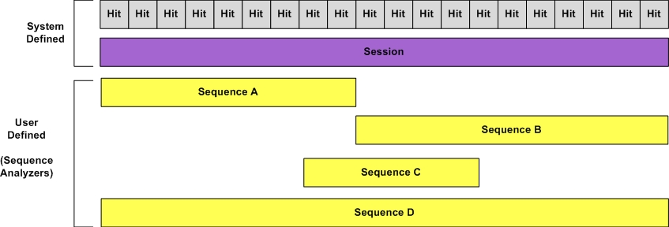
Data Model Overview
Hits
Sessions
Sequences (Previously Transactions)
Custom Fields (Hit, Session and Sequence Scoped)
Metrics (Analyzer, Sequence and Event Scoped)

Slide 11
Traffic Analyzers
Hit Analyzer (Previously Hit Filter)
Sequence Analyzer (Previously Transaction Filter)
Session Analyzer (Previously Session Filter)

Slide 12
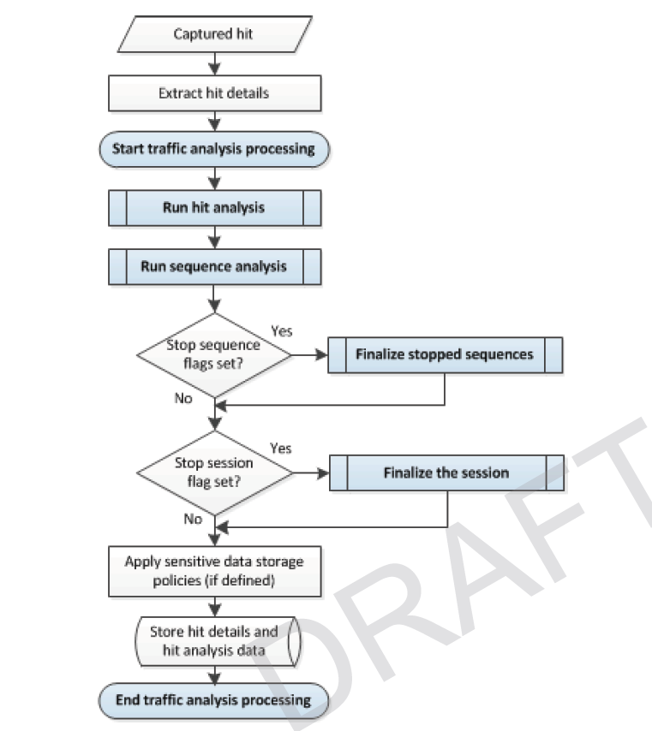
Traffic Analysis Processing

Slide 13
What’s inside a Hit Analyzer
Match/Error/Warning Conditions
Update Standard & Custom Metrics (Powerful with pivots)
Update Custom Fields
Execute Scripts (Groovy Based)
Storage Restrictions & Options

Slide 14
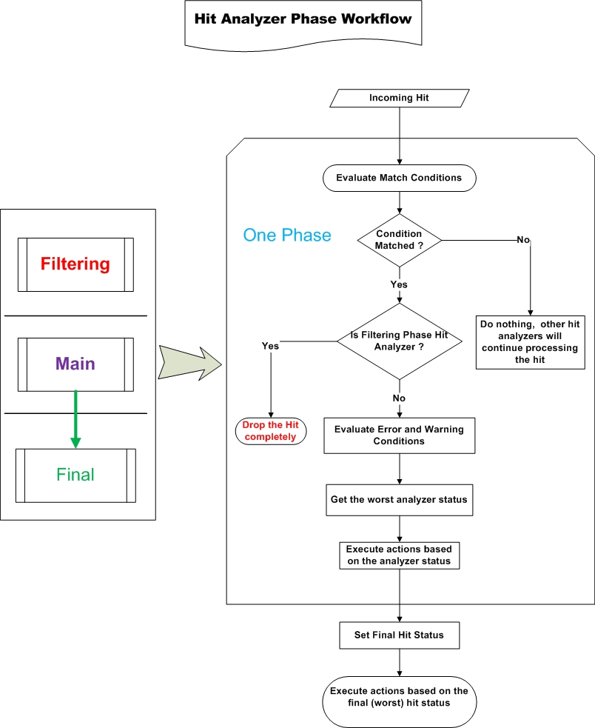
The Hit Analyzer Phase Concept
* More flexible & More powerful
* Filtering, Main and Final Phase

Slide 15
Hit Analyzer Demo…

Slide 16
Search & Session Explorer

Slide 17
The Pivot Chart in Search Results
Aggregate & Detail
Examples
Hit Count by City
Client Errors by ISP
Metric Update by Region

Slide 18
Pivot Chart Demo…

Slide 19
Content Replay
The Content Replay view allows End User users to visualize a session of interest by displaying it’s component Web pages as the end user originally viewed them.

Slide 20
Content Replay Demo…

Slide 21
Sequence Analyzer & Search Sequences
A Sequence Analyzer is a collection of conditions and actions used to analyze sessions as they are captured, and to identify the distinct sequences within those sessions.
Sequence Analyzers can be used to detect any activity within a session.
The key distinction between Hit Analyzers and Sequence Analyzers is that Hit Analyzers can only examine the hit currently being processed, while Sequence Analyzers can act on a series of hits within the active session
Sequence Analyzers are made up of a series of Sequence Events(events).

Slide 22
Sequence Analyzer & Search Sequences Demo…

Slide 23
End User Monitoring & APM in the future

Slide 24
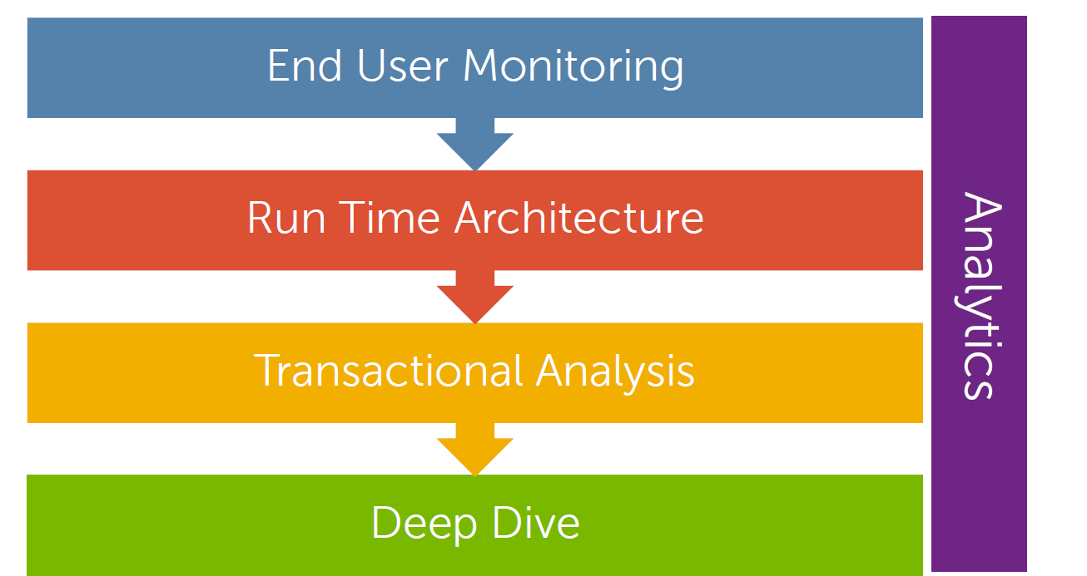
End User in APM - Workflow

Slide 25
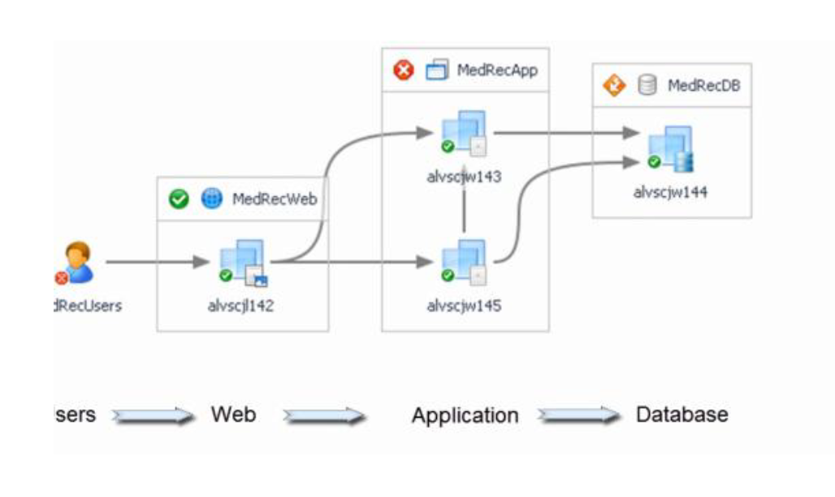
Transactional Analysis

Slide 26
New Stuffs in End User for APM
The Application concept
Common End User Topology Model (Top level transaction definition)
Browser Instrumentation (For Cloud Monitoring)
The Archiver will be a core component in new Foglight (for massive data storage)
Archiver Proxy (to communicate with different cartridges)

Slide 27
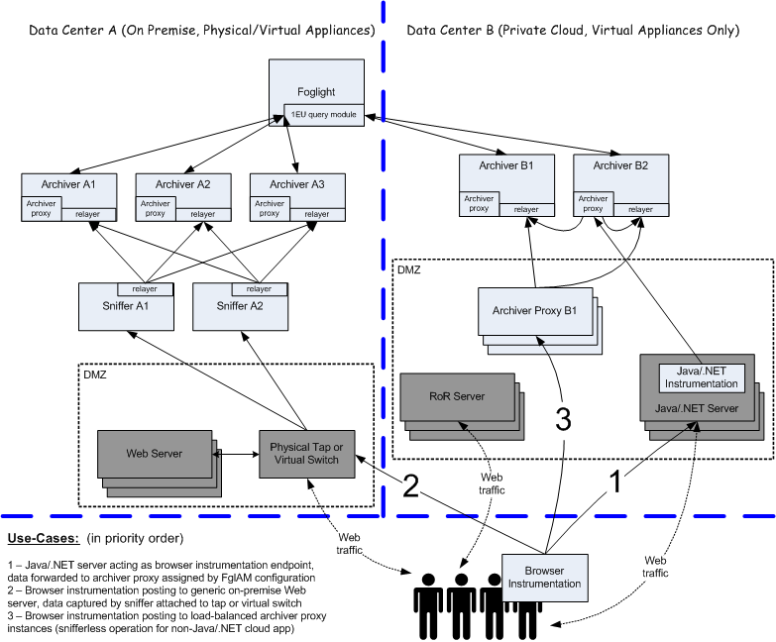
The Architecture

Slide 28
Questions?

Slide 29
Thank you

